Slide 1
CodeU’s
Bootcamp
Chapter 2
Welcome to your 1st session!
The class will start shortly...
Reproduction and distribution of the presentation deck is prohibited

Slide 2
Agenda for today’s class
Kahoot!
01
02
Course revision
To recap what was seen in the first chapter!
Let’s revise last chapter’s material!
Topic of the day:
03
04
Practice time!
Let’s warm up with some coding exercises!
Print, input, conditionals, strings and integers, etc.
Wrap-up
Conclusion
05
06
CodeU Robot
Summary of what we’ve learned today
homework and questions

Slide 3
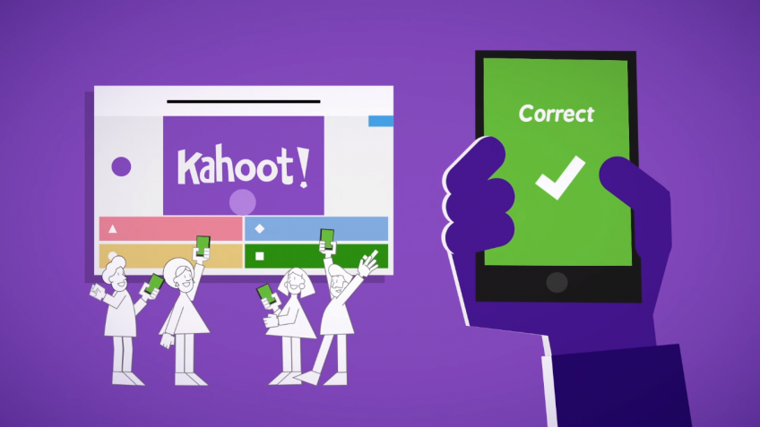
Time for Kahoot!
Head over to Kahoot.it for a fun coding quiz!

Slide 4
CodeU Class Rewards
points
50
Pizza/Hot-Dog day!
points
40
Popcorn & show
points
30
Donut Day!

Slide 5
Strings, Floats, Integers, and Booleans!
01
Strings
A string is a sequence of characters that is read as ONE element. It can be letters, numbers, symbols, and emojis
Example
“Robot”, “123”, “☺”
02
Integers
An Integer(int) is a value used to represent whole numbers that DO NOT HAVE decimals("numbers after the comma").
Example
5, 123, 0

Slide 6
Strings, Floats, Integers, and Booleans!
03
Floats
A Float(float) is a value used to represent numbers that HAVE decimals("numbers after the comma").
Example
2.0, 3.6666, 555.5555555
04
Booleans
Boolean statements are statements that evaluate to be true or false.
Example
Boolean = True, Boolean = False

Slide 7
Input Function
Quickly code one of these exercises!
Exercise 1
Exercise 1
Welcome to the world of Coding!
Let’s multiply two numbers!
Ask the user for their name using INPUT
Assign it to a variable
Concatenate the name variable with a welcoming message in the print() function
Ask the user for two different numbers
Assign them to 2 DIFFERENT variables
Multiply both variables in the print() function
*Concatenate: “glue” two strings together

Slide 8
Conditionals
Definition: Conditionals perform different actions depending on whether a condition is true or false. It is the way a computer reacts based on a decision.
Example: If a scary dog decides to chase you, you will run. If it doesn’t chase you, you will most likely just look at it. If there is no dog, there won’t be anything to do.
IF Statement
Elif Statement
Else Statement
It decides whether an action will be executed or not. If the condition is True, then it will be executed.
It verifies if another possible condition other than the one defined in If is True. Short for Else If.
Else statement catches any other possibility. It decides what to do if the condition is False.
Example
If name == “cat”:
print(“Miaow!”)
Example
Elif name == “Cow”:
print(“MOOO!”)
Example
Else:
print(“That is not an animal”)

Slide 9


ONE Quiz!
Exercise Description
You must create a ONE question Quiz where the user must answer correctly or else, they lose the game! The question can be about any subject or topic you would like. You must let the user know if they answered correctly or incorrectly.
1
Create a variable using the input() function. This will log the user's answer to your question.
4
Create a 2nd condition ELSE that catches any other possible answer.
4.1
Print a message letting the user know they answered correctly!
2
Create the 1st condition IF, where the user's answer must be equal to the correct answer.
2.1
Print a message letting the user know they answered correctly!

Slide 10




Thank you!
Does anyone have any questions?
Next class: Class 2
Please contact us if you have any questions or if you want to notify us for anything.
Phone:
(438) 391-9106
Email:
hello@codeu.ca

